Slide 1
WP1 Analysis of water resources management in the Western Balkan region
DI Kurt Glock
University of Natural Resources and Life Sciences BOKU, Vienna
Kick-off meeting / 21st December 2018
This project has been funded with support from the European Commission. This publication reflects the views only of the author, and the Commission cannot be held responsible for any use which may be made of the information contained therein.

Slide 2
WP1 – to do list Analysis of water resources management in the Western Balkan region
1.1 Identification of WB regional issues related to WRM
WB partners in cooperation with BOKU | 14.04.2019 (Report)
1.2 Analyse of EU innovations in water policy and EU recommendations and legislation in water sector
EU partners in cooperation with BOKU | 14.04.2019 (Report)
1.3 Analyse of existing curricula related to WRM in both EU and WB partner countries
EU and WB partners in cooperation with BOKU | 14.05.2019 (Report)
1.4 Identification of needed laboratory resources in WB HEIs and alignment with formed EU HEIs WRM laboratory equipment list
EU partners in cooperation with BOKU | 14.03.2019 (Report)
1.5 Workshop on innovative practices in the EU water sector: barriers and opportunities
Three-day workshop in Vienna in May 2019 | 14.06.2019 (Report)

Slide 3
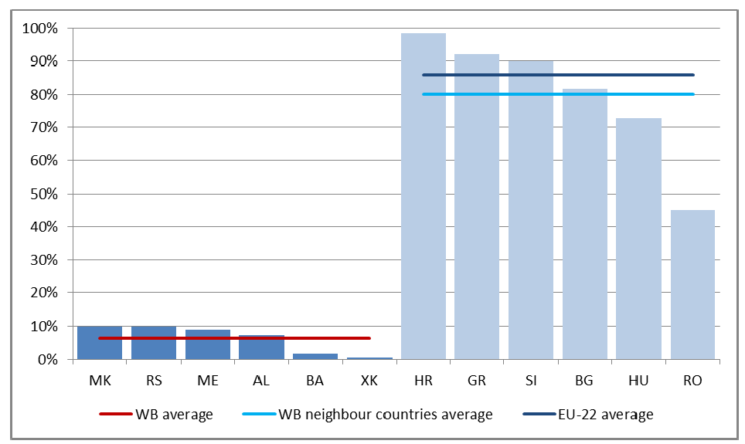
1.1 Identification of WB regional issues related to WRM
State of the water resources
Status of the water resource services
Issues related to water management
Review of responsible institutions, their staff and needed qualifications
Figure: Share of population connected to waste-water treatment in the year 2012 (Globevnik et al. 2018, ETC/ICM Technical Report)

Slide 4
1.2 Analysis of EU innovations in water policy and EU recommendations and legislation in water sector
Analysis of EU legislation in WRM (Water Framework Directive, EU Water Scarcity and Droughts Policy, Drinking Water Directive, etc.)
Implementation in EU project partners countries
Roadmap for further project initiatives (e.g. preparing of trainings for professionals)
Status of rivers
very good
good
moderate
poor
bad
Potential of rivers
good
moderate/poor
no info
Figure: Ecological status and potential of rivers (>10km²) in Austria (BMNT, 2018)

Slide 5
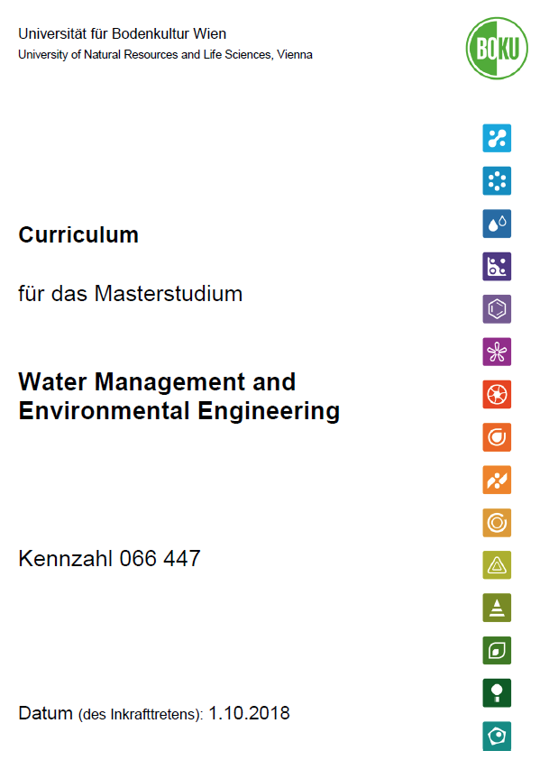
1.3 Analysis of existing curricula related to WRM in both EU and WB partner countries
Comparative analysis of structure and model of EU/WB curricula
Definition of needs of existing study programmes
List of EU curricula (Catalogue of Courses) including teaching methods and laboratory equipment
© BOKU, 2018

Slide 6
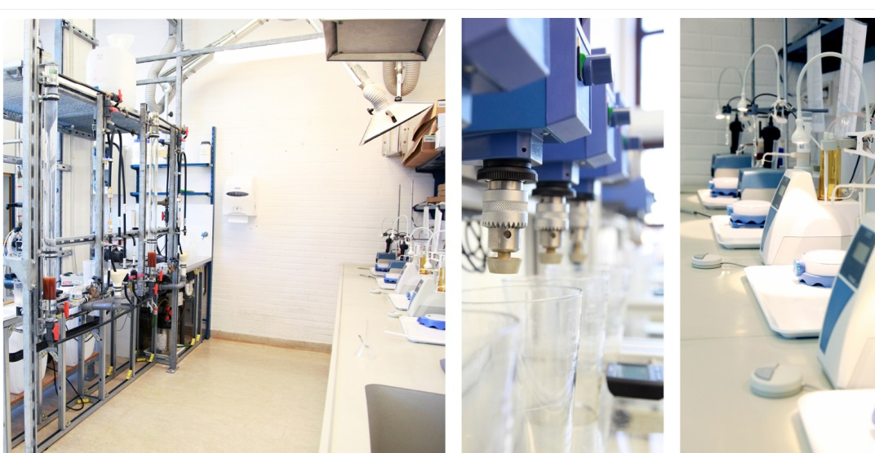
1.4 Identification of needed laboratory resources in WB HEIs and alignment with formed EU HEIs WRM laboratory equipment list
Specification of
Laboratory equipment list
Software
Literature
Prerequisite for public procurement procedures execution
© Ostfalia – Labor für Wasser- und Abwassertechnik, 2018

Slide 7
1.5 Workshop on innovative practices in the EU water sector: barriers and opportunities
Cooperation between educational sector and professional bodies
Engagement of water management professionals
Educational topics
Future incorporation in education
May 2019
© Interreg Slowenien - Österreich

Slide 8
WP1 – Invitation
1.1 Identification of WB regional issues related to WRM
WB partners in cooperation with BOKU | 14.04.2019 (Report)
Please provide us INFOS!
1.2 Analyse of EU innovations in water policy and EU recommendations and legislation in water sector
EU partners in cooperation with BOKU | 14.04.2019 (Report)
1.3 Analyse of existing curricula related to WRM in both EU and WB partner countries
EU and WB partners in cooperation with BOKU | 14.05.2019 (Report)
1.4 Identification of needed laboratory resources in WB HEIs and alignment with formed EU HEIs WRM laboratory equipment list
EU partners in cooperation with BOKU | 14.03.2019 (Report)
1.5 Workshop on innovative practices in the EU water sector: barriers and opportunities
Three-day workshop in Vienna in May 2019 | 14.06.2019 (Report)

Slide 9
Contact information
University of Natural Resources and Life Sciences Vienna (BOKU)
Department of Water, Atmosphere and Environment (WAU)
Institute for hydraulic engineering and river research (IWA)
Kurt Glock
Dipl.-Ing.
E-mail: kurt.glock@boku.ac.at
Michael Tritthart
Priv.-Doz. Dipl.-Ing. Dr.techn.
E-mail: michael.tritthart@boku.ac.at

